Slide 1
ME469: Review: Discretization, low-Mach, splitting/stabilization, advection stabilization
Stefan P. Domino^{1,2}
¹ Computational Thermal and Fluid Mechanics, Sandia National Laboratories
² Institute for Computational and Mathematical Engineering, Stanford
SAND2018-4536 PE

Slide 2
Fundamentals of Discretization: Surface vs Volume Integrations
Given a partial differential equation (PDE) and associated volumetric form:
Applying Gauss Divergence provides the standard finite volume form for fluxes in surface integral form (no distinction between internal control volume faces and boundary faces):
We can also multiple PDE by an arbitrary test function, w, and integrate over a volume,
Next, integrate by parts and apply
Gauss-Divergence. Note, that test function must be differentiable – shown here, at least once..
Interior
Boundary

Slide 3
Discretization Approaches: Two-state (Left) and Element-based (right)
Cell-centered
Control-volume finite element
Edge-based vertex-centered
Finite element

Slide 4
Final low-Mach Equation Set
The resulting Equation set is as follows:
Equation of state given by the thermodynamic pressure:
Energy transport is only required when the system modeled has a temperature difference
EOS does not provide an equation for closure: An alternative approach is required for motion pressure!
2+nDim

Slide 5
Thought Experiment… Solver Ramifications
For Elliptic systems, fixed point iterative solvers fail since the sequential propagation of information is not adequate for a system with infinite wave speeds
Walls
Inflow
All locations are strongly coupled
Outflow
Walls

Slide 6
Multigrid Methods: The Approach
Multigrid methods (MG) are essential for efficient solver performance in fluids-based Elliptic systems
In simple, structured domains, this can be geometric (GMG), while in unstructured, algebraic (AMG)
Restriction (from fine to coarse mesh)
Prolongation (from coarse to fine mesh)

Slide 7
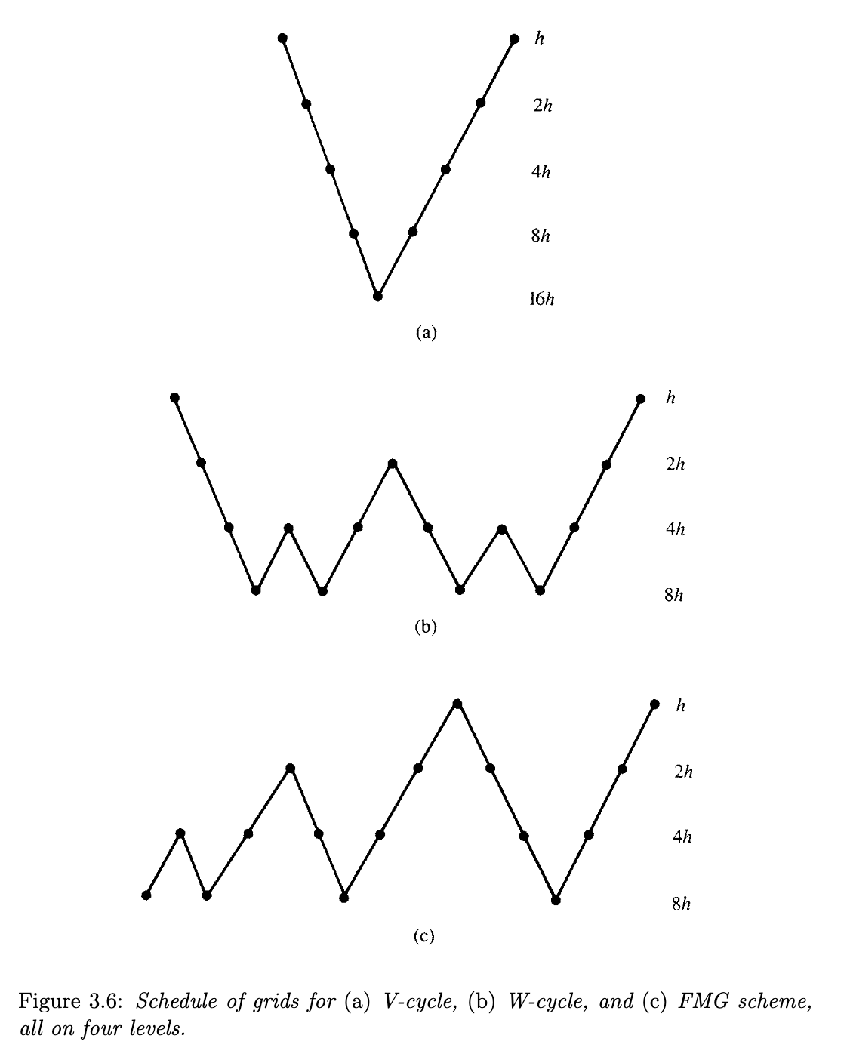
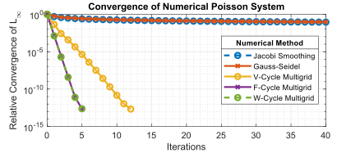
Multigrid Methods: V- and W-Cycles
Briggs (2000)
https://en.wikipedia.org/wiki/Multigrid_method

Slide 8
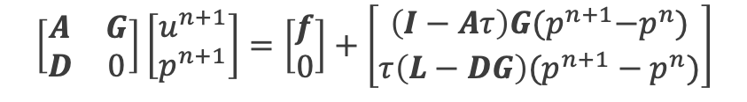
Pressure Projection and Block Factorization
Semi-discrete approach (uniform density) Fully discrete approach
Chorin (1968)
Time scale is the time step:
Fully discrete approach
Factored matrix: is an approximation to
SIMPLE family of methods
Time scale is the characteristic scale of :
For convection-dominated flows, this looks like Δx/U
$$\left[\begin{matrix}A & G \\ D & 0\end{matrix}\right]\left[\begin{matrix}u^{n+1} \\ p^{n+1}\end{matrix}\right]=\left[\begin{matrix}f \\ 0\end{matrix}\right]+\left[\begin{matrix}\left(I−Aτ\right)G{(p}^{n+1}−p^{n}) \\ {τ\left(L−DG\right)(p}^{n+1}−p^{n})\end{matrix}\right]$$

Slide 9
Monotonic Issues at High Pe: Simple Matrix Analysis
Consider our passive scalar concentration whose natural range (as a mass fraction) is bounded between zero and unity, here, shown as a stationary transport equation:
Using our CDS and standard diffusion operator yields the following matrix system:
With coefficients, and:
Substituting: and defining:
Yields:
u_{x}
i-1
i
i+1
Positive for Pe < 2
For Pe < 2, the value of the scalar at node i is a linear combination of the neighboring values

Slide 10
Monotonic Issues at high Pe: Alternative View (Diagonal Dominance)
Define Diagonal Dominance as:
For a monotonic operator and ease of solving the linear system, diagonal dominance is desired
In our advection/diffusion case, this is expressed as:
Which, again, is only ensured when the Peclet number is less than two

Slide 11
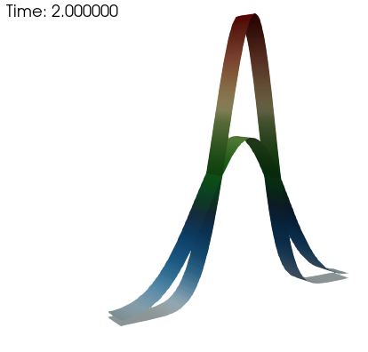
Monotonic Issues Resolved When Using First-order Upwind
u_{x}
i-1
i
i+1
However, at what price?
Positive for all Pe
Fully bounded with
diagonal dominance
First-order, upwind (FOUPW)
Volume-of-fluid example (Domino and Horne, Renew. Ener. 2022)

Slide 12
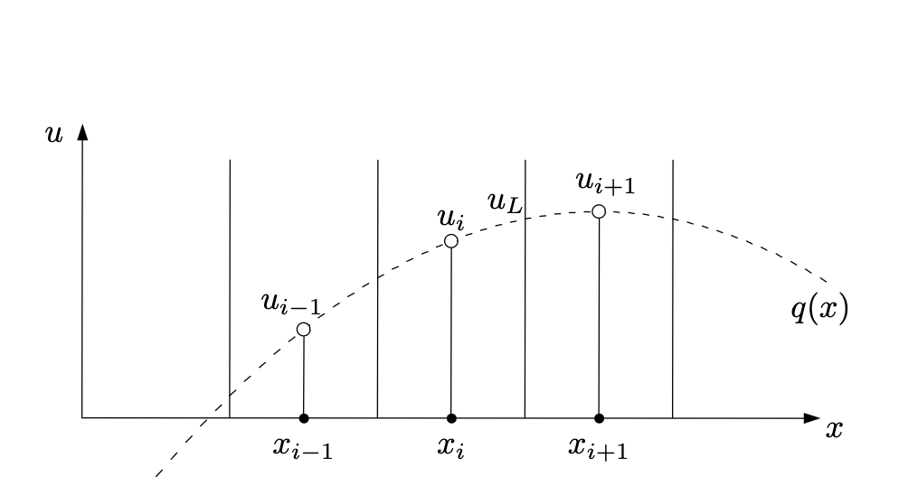
General Kappa-Method of Hirsh Numerical Computation of Internal and External Flows, vol. 2, John Wiley & Sons, 1990
For the edge defined by the i and i+1 node, define a Left and Right state:
For κ = +1, we simply revert to CDS
For κ = -1, Second-order upwind
For κ = 2/3, QUICK (Leonard, “A stable and accurate convective modelling procedure based on quadratic up-stream interpolation”, Comput. Methods Appl. Mech. Eng. 19 (1979) 59–98.)
Quadratic basis (three-points required)

Slide 13
Classic Flux Limiters Van Leer, B. (1974), "Towards the ultimate conservative difference scheme II. Monotonicity and conservation combined in a second order scheme", J. Comput. Phys., 14 (4): 361–370
Consider our standard three-point stencil obtained by iterating edge 1 and 2
In the above stencil, we are stressing that when iterating edge 2, we do not have information easily obtain for edge 1 (shown above as a dashed line); (speaking from an unstructured perspective)
Above, the “LOW” and ”HIGH” are any operators that you select, e.g.,
u_{x}
i-1
_{φι-1/2}
i
_{φι+1/2}
i+1
Edge 1
Edge 2
Monotonic upstream-centered
scheme for conservation laws (MUSCL)

Slide 14
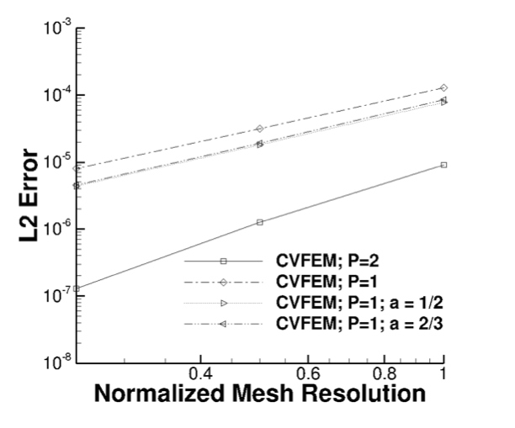
Blending Approaches to Arrive at Pseudo Higher-order Methods: Upwind and Central
Define an upwind operator now at an arbitrary integration point:
And for a generalized CDS scheme:
Two new blending parameters: α_{upw} and α

